Slide 1

A TEACHER FOR ALL SEASONS

Slide 2
“A teacher is like Spring,
Who nurtures new green sprouts,
Encourages and leads them,
Whenever they have doubts.
A teacher is like Summer,
Whose sunny temperament
Makes studying a pleasure,
Preventing discontent.
A teacher is like Fall,
With methods crisp and clear,
Lessons of bright colors
And a happy atmosphere.
A teacher is like Winter,
While it’s snowing hard outside,
Keeping students comfortable,
As a warm and helpful guide.
Teacher, you do all these things,
With a pleasant attitude;
You’re a teacher for all seasons,
And you have my gratitude!
By Joanna Fuchs “

Slide 3
The theme of the poem
The poet expresses gratitude to a teacher for being a truly perfect person- suitable for all seasons.
A person with a pleasant, encouraging attitude that wins hearts wherever she/he goes.
This poem pays tribute to a teacher, listing the various roles she takes on as a friend and guide to her students. The poet compares the various roles of the teacher to the four seasons showing us how a teacher nurtures her student’s all-round growth.

Slide 4

A teacher………..doubts.
Spring season takes great care of the new plants and leaves. Spring gives them water and light sunlight, breeze and dew drops for their growth.
TEACHER = SPRING
TEACHER = SPRING

Slide 5
SO HOW IS A TEACHER LIKE 'SPRING' ?
THE TEACHER IS LIKE THE SPRING SEASON BECAUSE SHE OFFERS THESE NEW PLANTS ( HER STUDENTS) PROTECTION AGAINST THE ELEMENTS OF EVIL AND GUIDES THEM TO THE RIGHT PATH. A TEACHER NURTURES HER STUDENTS.
A TEACHER LOVES HER CHILDREN, NURTURES THEM LOVINGLY, LEADS THEM THROUGH DOUBTS AND ENCOURAGES THEM TO LEARN AND BE SUCCESSFUL, LIKE THE SPRING.

Slide 6
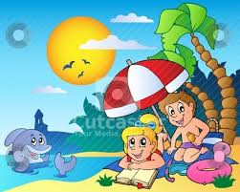
‘A TEACHER…………DISCONTENT.’
DURING SUMMER, THE SUN IS WARM AND BRIGHT. IT GIVES WARMTH, LIGHT AND LIFE TO ALL.
TEACHER = SUMMER
TEACHER = SUMMER

Slide 7
so HOW IS THE TEACHER LILE ‘SUMMER’ ?
A TEACHER IS LIKE SUMMER AS SHE IS ALWAYS GOOD-TEMPERED. HER CHEERFUL BEHAVIOR ENSURESTHAT TEACHING-LEARNING IS FUN.
SHE UNDERSTANDS HER STUDENTS AND IS TOLERANT OF THEIR SHORTCOMINGS.
SHE IS NOT DULL. WHOEVER LEARNS FROM HER GETS MOTIVATED AND ENLIGHTENED. LIKE THE SUN, SHE SPREADS LIGHT, WARMTH AND LIFE BUY BURNING FOR OTHERS.

Slide 8
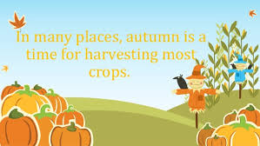
‘A TEACHER …………….ATMOSPHERE.'
Fall is a time when fruits and leaves reach ripeness. During this time leaves and fruits get new colors and smell and taste. Hills and valleys are colorful and orchards are overflowing with the scent of mellow fruits.
TEACHER = FALL
TEACHER = FALL

Slide 9
SO HOW IS A TEACHER LIKE’FALL’?
JUST LIKE THE AUTUMN SEASON, HER TEACHING BRINGS ALIVE THE BRIGHT COLORS AND CRISPNESS OF NATURE AND THIS MANNER SHE IS LIKE AUTUMN.

Slide 10
THE LAST STANZA-
Teacher, you do all these things,
With a pleasant attitude;
You’re a teacher for all seasons,
And you have my gratitude!
Human life undergoes various changes – happiness, failures, hardship and dullness. As students, a teacher is their best guardian and guide to pass these troublesome childhood days. A teacher is caring, motivating, warm and covering throughout a child’s life.

Slide 11
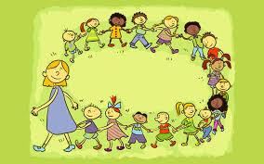
A HAPPY TEACHER- STUDENT CLASS

Slide 12
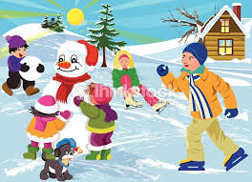
‘A TEACHER………….GUIDE.’
Winter is cold but the same winter protects its animals and birds and trees. Winter sheds leaves, send the animals to sleep in their furrows and blankets the earth and insects under heavy cover of the fallen leaves.
TEACHER = WINTER
TEACHER = WINTER

Slide 13
SO HOW IS A TEACHER LIKE ‘ WINTER’ ?
A teacher is like winter because she makes sure that her students are warm and comfortable in her company despite any troubles that they may face. She also guides them, offering them all the benefit of her own experience.

